Slide 1
Environmental Impact Assessment (EIA)
EIA Methodologies
Unit - II

Slide 2
Criteria for the Selection of EIA Methodology
EIA methodologies should have the following qualities
Should be systematic in approach
Should be able to organize the large mass of heterogeneous data.
Should be able to quantify the impacts.
Should be capable of summarizing the data.
Should have a good prediction capability.
Should extract the salient features.
Should finally be able to display the raw data and derived information in a meaningful fashion.

Slide 3
Common criteria to select the methodology are
A) General
B) Impact Identification
C) Impact Measurement
D) Impact Interpretation and Evaluation
E) Impact Communication

Slide 4
General
1) Simplicity- the methodology should be simple so that the available manpower with limited background knowledge can grasp and adapt it without much difficulty.
2) Manpower and Budget Constraints-
the methodology should be applied by a small group with a limited budget and under time constraints.
3) Flexibility –the methodology should be flexible enough to allow for necessary modifications and changes through the course of the study.

Slide 5
b) Impact Identification-
Comprehensiveness- the methodology should be sufficiently comprehensive to contain all possible options and alternatives and should give enough information on them to facilitate proper decision making.
Specificity- the methodology should have specific parameters on which there would be significant impacts.
Isolation of project impacts- the methodology should suggest procedures for identifying project impacts from future environmental changes.
Timing and duration the methodology should be able to identify accurately the location and extent of the impacts on a temporal scale.

Slide 6
c) Impact Measurement
Commensurate Units– the methodology should have a commensurate (corresponding to size or degree )set of units so that comparison can be made between alternatives and criteria.
Explicit Indicators- the methodology should suggest specific and measurable indicators to be used to quantify impacts on the relavant environmental parameters.
Magnitude- the methodology shouls provide for the measurement of impact magnitude.
Objective Criteria- the methodology should be based on objective criteria and criteria should be stated explicitly.

Slide 7
d) Impact Interpretation and Evaluation-
1)Significance-it should be able to assess the significance of measured impacts on local, regional and national scale.
2) Explicit Criteria the criteria and assumptions employed to determine the impact significance should be explicitly stated.
3) Uncertainty- uncertainty of possible impacts is a real problem in EIA. The methodology should be able to take this aspect into account.

Slide 8
4) Risk -should identify the impacts that have low probability of occurrence but a high potential of damage and loss.
5) Depth of Analysis- the conclusions derived from the methodology should be able to provide sufficient depth of analysis and instill confidence in the users, including general public.
6) Alternate Comparison- it should provide a sufficiently detailed and complete comparison of the various alternatives readily available for the project under study.

Slide 9
e) Impact communication-
Affected parties- it should provide a mechanism for listing impacts to specific affected geographical or social groups.
Setting description-it should provide a description of the project setting to aid the users in developing an overall perspective.
Summary Format-it should provide the results of the impact analysis summarized in a format that will give the users who range from the lay public to the decision makers.

Slide 10
Methodologies
There is no universal methodology of EIA , so far which can be applied to all project types in all environmental settings. (Bisset, 1980)
A number of methodologies are available for EIA.
Warner (1973) has divided all available methods into 5 main categories. (a) Adhoc (b) Overlay
(c) Checklists (d) Matrices (e) Networks
Apart from these, there are some specific approaches of economics like CBA, Input –output technique available for EIA.

Slide 11
Adhoc
These are very simple methods based on subjective or intuitive assessment of environmental impacts on broad aspects.
A team of specialists depending on their areas of expertise would give minimum guidance without going into detailed scientific investigation of environmental impacts of the projects.
The impacts such as short term, long term,reversible, irreversible etc. are examined merely on guess basis.
This method is very easy but has few drawbacks.
It may not encompass all the impacts
The criteria used to evaluate impacts are not comparable
It provides minimal guidance for impact analysis.

Slide 12
(b) Overlay
-is a Geographical Approach developed by MC Harg (1968,69).
-this method relies on maps of project areas, environmental characteristics covering Physical, Social, Ecological and Aesthetic aspects.
Comprehensive description of the areas is given.
Computer programs are used to overlay the maps and thus arrive at a conclusion , reg. the impacts of the project.

Slide 13
(c) Checklist:
Is different from adhoc methods.
They are quite elaborate.
Systematic assessment of environmental impacts of projects is done.
Checklist means listing of Potential Environmental Impacts.

Slide 14
Types of Checklist: It is of 4 types
1) Simple Checklist- no information is given
2) Descriptive Checklist –gives data , measurement and impact prediction details
-by using the checklist method, EIA now assesses the nature of the impact i.e., adverse and beneficial , short term and long term , reversible and irreversible etc.

Slide 15
3)Scaling Checklist– is similar to descriptive checklist , and has additional information on subjective scaling of the parameters.
4) Scaling Weighing Checklist– is similar to scaling checklist with additional information on subjective evaluation of each parameter w.r.t all other parameters.

Slide 16
Environmental parameters
S.No. | Project | Air | Water | Land | Noise | Flora and fauna | Historical Cultural importance
1 | Industry | √ | √ | √ | √ | √ | √
2. | Dams |  |  | √ | √ | √
3 | Mining | √ | √ | √ | √ | √
4 | Petroleum | √ | √ | √ | √ | √
5 | Distilleries
6 | Roads and Railways
7 | Pesticides

Slide 17
Types of Impacts
Short Term Impacts- loss of flora and fauna ,soil erosion
Long Term Impacts- deforestation , desertification, increase in temperature, decrease in rainfall, climate changes
Direct Impacts–loss of flora and fauna, soil erosion , health hazards
Indirect Impacts- deforestation, desertification, increase in temperature, decrease in rainfall, climate changes, global warming, air pollution

Slide 18
Predictable Impacts: air pollution , water pollution ,soil pollution ,deforestation, loss of flora and fauna.
Unpredictable Impacts: global warming, depletion of ozone layer, acid rains etc.
Positive Impacts job opportunities, development of science and technology, increase in country’s economy, increase in goods, increase in consumerism, increase in standard of living.
Negative Impacts all the above except positive impacts.

Slide 19
(d) Matrix method gives a framework of interaction of different actions of projects with environmental impacts.
Leopold et.al (1971) assessed the various impacts of the developmental projects .
Identifies interactions between various project actions and environmental parameters and components.
Gives a list of project activities with a checklist of environmental activities that may be affected.
A matrix of potential interactions is produced by combining these lists (placing one on the vertical axis and the othe ron the horizontal axis).

Slide 20
ENVIRONMENTAL MEDIA QUALITY INDEX METHOD
Introduction
Several steps are involved with the development of numerical indices (or classification of environmental quality or pollution potential of human activities).
These steps include
Identification
Assignment of important weights
Establishment of scaling sections
Other methods for factor evaluation
Termination
Implementation of the approach and
Application of field verification.

Slide 21
Air Pollution Index
Air pollution is a result of the combined effects of different pollutants rather than a single pollutant.
The magnitude of air pollution in such cases is difficult to be assessed on the basis of the concentration of individual pollutants alone, but the goal can be achieved by applying certain indices. Any pollution index should indicate the gross level of pollution with reference to the standard limits of the individual pollutants.

Slide 22
It should be easy to understand and should include the major air pollutants.
Water Quality Index
For calculating the water quality index,
there are 9 individual variables
Dissolved Oxygen, Fecal Coliform
pH, Biological Oxygen Demand
Nitrates, Phosphates
Temperature deviation, Turbidity and
Total Solids

Slide 23
 | Pollutant levels(in mg per liter) index value | Air quality level | General health effects | Cautionary statements
Hazardous | 500 | Significant harm | Premature death sick and elderly people will experience adverse symptoms that effect their normal activity | All persons should remain indoors All persons should minimize physical exertion and avoid traffic
 | 400 | emergency | Premature onset of certain disease in addition to significant symptoms and decreased exercise tolerance in healthy persons. | Elderly and persons with existing disease should stay indoors and avoid physical exertion. General population should avoid outdoor activity.
 | 300 | warning | Significant aggravation of symptoms and decreased exercise tolerance in persons with heart or lung disease with widespread symptoms in the healthy population. | Elderly and persons with existing heart or lung disease should stay indoors and reduce physical activity
Unhealthy | 200 | alert | Mild aggravation of symptoms in susceptible persons with irritation symptoms in the healthy population. | Persons with existing heart or respiratory ailments should reduce physical exertion and outdoor activity.

Slide 24
Cost Benefit Analysis (CBA)
Also called Benefit Cost Analysis (BCA)
is a systematic approach to estimate the strengths and weaknesses of the options to achieve benefits while preserving savings ( for eg. In transactions etc.)
-CBA first compiles a comprehensive list of all the costs and benefits associated with the project.
Costs include – cost of risks such as regulatory risk,( risk that a change in laws and regulations will impact a business or market etc.) environmental impacts etc.

Slide 25
CBA estimates and totals up the equivalent money value of the benefits and costs. These projects may be dams, highways , training programs , health care systems etc.
Cost summary is broken down into its constituents and comparison of the costs is done.
There are 4 types of cost analysis
1) Investment cost analysis
2) Cost allocation analysis
3) Cost effectiveness analysis and
4) Cost benefit analysis.

Slide 26
Objectives of Cost Accounting
-Ascertainment of cost.
-Fixation of selling price.
-Proper recording and presentation of cost data.
-Cost control.
Cost reduction.
Ascertaining the profit of each activity.
Assisting management in decision making.

Slide 27
CBA in EIA
CBA is undertaken to weigh the costs of a project against the benefits.
CBA tries to put a monetary value on both costs and benefits so that they are expressed in same units.
Environmental cost benefit analysis refers to assessing policies and projects that might effect the environment
The Environmental Management Plan (EMP) covers the design , construction , operation and maintenance of each project component .
EMP identifies the environmental issues and provides plans to manage them effectively.

Slide 28
Types of Environmental Monitoring
Three main types of environmental monitoring are
Air 2) Soil 3) Water
Air monitoring is done via air sampling which can be passive or diffusive.
Environmental Quality Index Method (EQIM)
An overall estimate of environmental quality is needed to improve our understanding of the relationship between environmental conditions and human health.
An nEvironmental Quality Index(EQI) was developed for all the countries using indicators from chemical, natural, built and social environment.

Slide 29
Five environmental domains are
-air
-water
- land
-built and
- socio demographic.
EQI is used in 2 ways,
As an indicator of ambient conditions in environmental health modelling,
As a covariate to adjust for ambient conditions in environmental models.

Slide 30
Other uses are expected by different end users such as
-Local People
-County
-State Govt.
-Non government organisations (NGO)
-Academic institutions
-EQI summarises many variables into a single variable.
-EQI is one approach that improves statistical efficiency and accounts for many environmental exposures at once.
-EQI identifies areas with different levels of environmental quality.

Slide 31
Deforestation refers to the elimination of forest resources or cutting of trees or loss of forest cover.
-in this process , the forest area is completely converted into agricultural area and then this area is converted into desert.

Slide 32
The total forest cover of the world was 7000 M ha in 1900, which was reduced to 2890 M.ha in 1975, then fell down to just 2300 M.ha in 2000.
Rate of deforestation is very less in temperate countries ,but it is very high in tropical countries.
In India about 1.3 M.ha. Is lost due to deforestation.
The per capita availability of forest in India is 0.08 hectares per person which is much lower than the world average of 0.8 hectares.

Slide 33
Youtube links on Deforestation
https://www.youtube.com/watch?v=Iaxc2RuRnCQ&t=4s ( Australia Forest Fires - 2019)
https://www.youtube.com/watch?v=-Yw5MM2-aR8 ( Australia Forest Fires - 2019)
https://www.youtube.com/watch?v=Ic-J6hcSKa8
(Deforestation Video)
https://www.youtube.com/watch?v=SAZAKPUQMw0 ( Amazon Forest Fires)

Slide 34
https://www.youtube.com/watch?v=vMBHkF0y71s
https://www.youtube.com/watch?v=dJpNLfD84gA
https://www.youtube.com/watch?v=ZXMXmswrtOg
https://www.youtube.com/watch?v=3z7cH8SfsME
https://www.youtube.com/watch?v=RDIbs5GYfeQ
https://www.youtube.com/watch?v=J__4V0ujlaU – BBC NEWS

Slide 35
Causes of Deforestation
Population Explosion
Demand of Wood for Industries
Mining Activities
Overgrazing
Construction of Roads and Railways
Fires
Developmental activities like Dams
Agriculture

Slide 36
Population Explosion
Is the main cause for all environmental problems including deforestation.
As population increases , the requirement for timber, fuel, paper, wood increase.
To meet these requirements, man has started cutting down the forests that caused deforestation leading to desertification.
Felling of trees provides a source of income for billions of people throughout the world and forest products are useful in many ways.

Slide 37
Demand of Wood for Industries
Wood is used for several industrial processes such as making of boxes, crates, packing cases, furniture, match boxes, paper, plywood etc.

Slide 38
Mining Activities
-Have a serious impact on forest resources.
-Large scale deforestation has been reported from Dehradun in 1989 due to indiscriminate cutting of forests for mining activities .
-Mining operations and dams damage and effect the valuable forest land.
-Dams also damage downstream eco systems.

Slide 39
Overgrazing
Of forests by livestock results in deforestation.
Construction of Roads and Railways
Along forests and mountains is also a cause of forest degradation.
Fire
Is the worst enemy of forest.it destroys the forest area and also causes large scale damage to animal life.

Slide 40
Developmental Activities
Dams, reservoirs, hydro electrical projects etc.
Projects submerge forest areas.
These forests displace large number of tribal people and cause great damage to forests.
Agriculture
Cutting of trees to cultivate agricultural land leading to deforestation.

Slide 41
Other Causes are
-Urbanization
Subsistence Farming
Desertification
Mining
Forest Mining

Slide 42
Types of Causes of Deforestation
1)Natural causes – flood, forest fire, climate change
2)Manmade causes – housing, agriculture, furniture
Effects of Deforestation or Environmental Impacts of Deforestation
1)Economic effects
2) Long term effects
3) Short term effects

Slide 43
Economic Effects – Short Lived Boom
Long Term Effects
-Climate Change
- Global Warming
- Loss of Plant and Animal species
- Agriculture Damage
3) Short Term Effects
- Soil Erosion
-Change in Precipitation

Slide 44
Other Effects are
-Release of Green House Gases
-Droughts
-Increase in Temperature
-Animal Death or Extinction
- Vegetation and Resources lost-- Disrupted water cycles
-Disrupted Livelihood
- Loss of Biodiversity

Slide 45
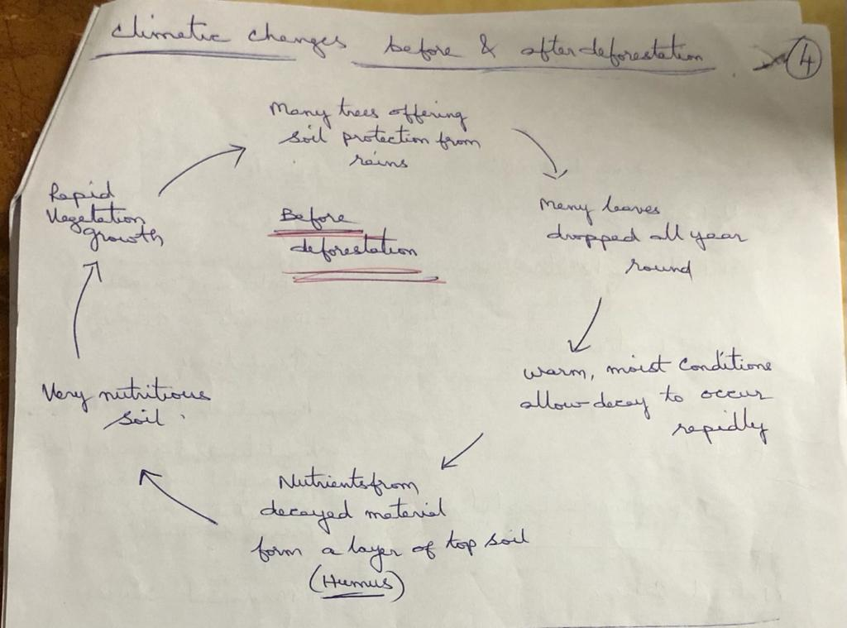

Slide 46
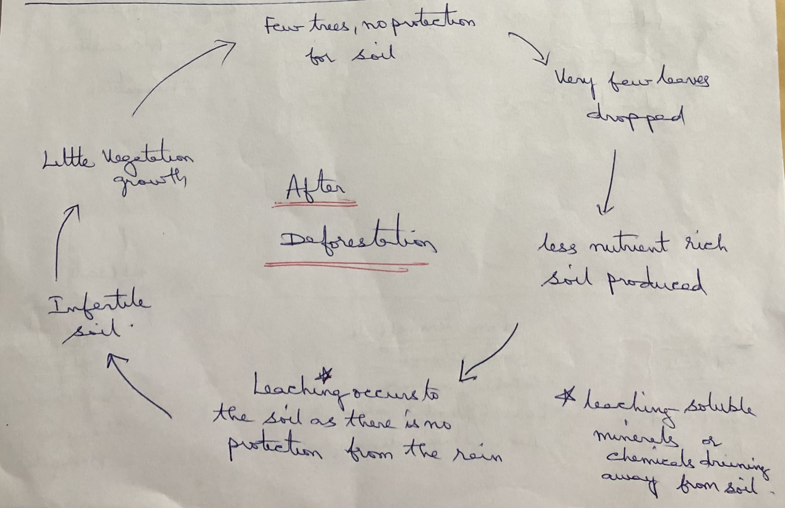

Slide 47
Impacts of Deforestation
1)Impacts on Climate Change
-Drastic changes in climatic conditions
-Increase in temperature
Changes in rainfall pattern
2) Impacts on Biodiversity
-loss of wild life species
-Extinction of flora and fauna
3) Impacts on Economy
Yield product decreases

Slide 48
4) Impacts on Land Resources
Soil erosion
Soil quality and quantity will be effected
Loss of nutrients from soil
5)Impacts on Food Resources
-as yield production decreases , food production decreases.
Lot of variation in supply and demand of product
Increase in prices of food materials.

Slide 49
THE END

